Slide 1


Impact of Science Conference the Plenary Session on:
Models, Approaches & Lessons for the Development of a Research Impact Agenda
24th June, 2021

Slide 2


Impact of Science
23-25 June, 2021
Chris Brink : Former Vice-Chancellor of Newcastle University (UK) & Chair of the 2020 Research Assessment Exercise Group, University Grants Committee, Hong Kong
Wendy Larner: President of the Royal Society Te Apārangi, New Zealand
Johann Mouton: Director of the DST-NRF Centre of Excellence in STI Policy, CREST, Stellenbosch University, South Africa
Genevieve Simpson: Director Strategy, Planning, Partnerships National Research Foundation, South Africa
Overview of the Speakers
#IOS21

Slide 3
Impact of Science
23-25 June, 2021
Wendy Larner
President of the Royal Society Te Apārangi, New Zealand
#IOS21

Slide 4

Royal Society Te Apārangi: Developing a Research Impact Agenda
Professor Wendy Larner
President
Impact of science

Slide 5
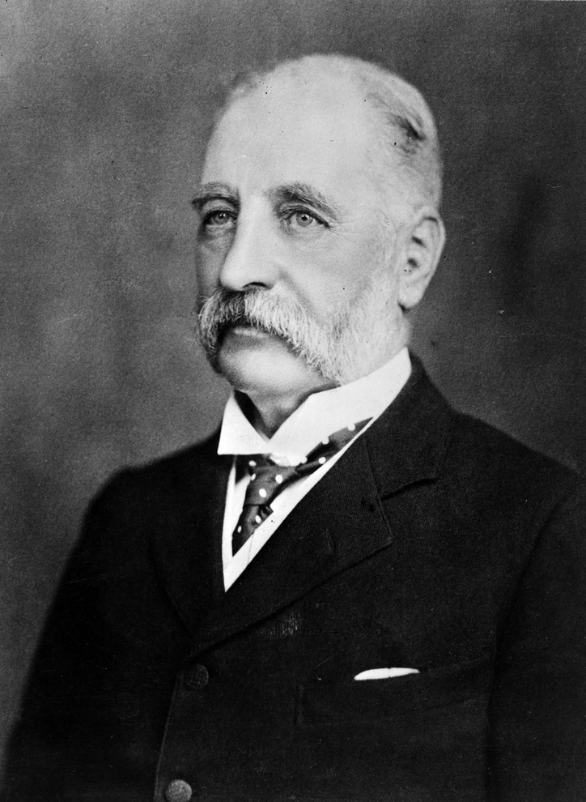

Royal Society
Te Apārangi
1867
James Hector sets up the New Zealand Institute
1933
Royal Society of New Zealand established
2007
New name of Te Apārangi gifted by Professor James
Wharehuia Milroy
2012
Remit expanded to include social sciences and
humanities

Slide 6

Three Priorities
Enhancing equity and diversity in all its forms
Building stronger relationships with Te Ao Māori
Better support and recognition of early career researchers

Slide 7

Research Impact Implications
Better reflection of the increasingly heterogenous nature of our research sector
Understand the past, present and future role of indigenous knowledges
Engage with the priorities and experiences of a more diverse, more precariously employed, generation of researchers

Slide 8

Research excellence is more collaborative, more interdisciplinary and more engaged that usually recognized
Rethinking excellence
Allows us to better recognize the contributions of women, applied researchers and Māori and Pasifika researchers.
Has required stronger engagement beyond the universities, including with government scientists, independent research
organisations and Maori organisations
2020 cohort of Fellows was 50% Māori

Slide 9


Rethinking relationships
Changing who we are and how we do things, including building cultural and linguistic confidence
Developing reciprocal and mutually respectful relationships well beyond traditional academic networks
Bringing our expertise to bear on issues of concern to the New Zealand public
  New Zealand School curriculum
  Early career labour market
  Kura Kaupapa schools

Slide 10
Conclusion
High quality research, information and knowledge are crucial to better economic, environmental and social outcomes
Need a research sector that better reflects our wider communities
Will require us to rethink excellence and foster new relationships
Interdisciplinary and epistemological diversity are increasingly important in this changing research landscape
Aim is a more just environmental, economic and social future
Impact of science

Slide 11
Impact of Science
23-25 June, 2021
Johann Mouton
Director of the DST-NRF Centre of Excellence in STI Policy, CREST,
Stellenbosch University, South Africa
#IOS21

Slide 12
A M&E Framework for the SA STI system
Johann Mouton
AESIS Conference
24 June 2021

Slide 13
Background
There is currently no integrated or co-ordinated Framework for the monitoring and evaluation of the performance of the SA STI system. Instead, we have very disparate M&E elements across the system that have developed (mostly in isolation) from each other over the past two decades and do not speak to each other. Over the past twenty years more than 100 national, sectoral and programmatic STI evaluations and reviews have been conducted in SA, but again without any co-ordination and certainly with no accumulative learning.
In this presentation I present the outline of an integrated M&E Framework for the SA STI system based mainly on a study that the DST-NRF Centre of Excellence in Scientometrics and STI Policy undertook under commission by NACI in 2019. The full report of this study is now available on the NACI website.

Slide 14
Four key premises
Understand the differences between ‘monitoring’ and ‘evaluation’ questions.
Understand the layered nature of the STI system and the need to differentiate between levels of monitoring and evaluation.
Understand the strengths and weaknesses of different M&E methodologies and how to optimally integrate qualitative (peer review) and indicator-based approaches in one framework.
Incorporate lessons learnt from 60 years of programme evaluation studies and specifically where and how to apply the logic of interventions and the value of theory-based approaches to evaluations.

Slide 15
Monitoring and evaluation
Monitoring is defined as the consistent and regular measurement of key dimensions of the STI system (primarily at the systems and sectoral levels) through the use of appropriate and standardized input, process, output and impact indicators. In a well-defined monitoring framework, and depending on the availability of data, this allows for both domestic and international benchmarking of the SA STI system.
Evaluation is defined as the rigorous assessment of the key outcomes and impact of different lower-level objects in the STI system (especially intervention and research strategies and programmes), in terms of appropriate evaluation criteria (effectiveness, relevance, efficiency, scientific and societal impact and transformative contribution). Evaluations typically address how and why questions and are undertaken to coincide with major strategic planning decisions (to inform resource allocation priorities) as well as meeting the demands of accountability and learning.

Slide 16
Level of M&E and appropriate methodologies
(National) STI system (and sectors)
Predominantly indicator-based approaches (supported by peer-review mechanisms)
STI institutions (research and innovation institutions)
Application of both customized programme-level indicators (LM) and more qualitative survey and peer review methods
STI relevant intervention programmes (funding/ capacity-building)
Theory-based evaluation approaches with mixed-methods designs (interviews, case studies, causal pathway analyses)
Research (programmes and projects)

Slide 17
Monitoring: A SA STI scoreboard

Slide 18
An analytical framework for a STI scoreboard
The analytical framework that underpins the scoreboard distinguishes between the following four ‘main system-level dimensions:
Inputs and enablers (tangible investments, human capabilities and infrastructures);
Flows and linkages (collaborations, networks and connectivity);
Outputs (tangible scientific, technological and innovation products);
Outcomes and impacts (socio-economic and developmental outcomes and benefits).
The framework in the table below ‘cross-tabulates’ these dimensions with four levels of increasing disaggregation:
Level 1 (Main dimension)
Level 2 (Sub-dimension)
Level 3 (Indicator category)
Level 4 (Indicators – not included in the slides below)
In addition the framework also indicates whether each indicator can be used for domestic and/or international benchmarking.

Slide 19
Level 1 | Level 2 | Level 3 | Domestic benchmarking | International benchmarking
Inputs and enablers: Investment and expenditure | Public expenditure on R&D | GERD by Sector | √ | √
 |  | GERD by type of R&D | √ | √
 |  | GERD by socio-economic objective | √ | √
 |  | Funding of R&D by source | √ | √
 |  | GBARD | √ | √
 |  | Tax reliefs and incentives | √ | √
 | Innovation expenditure | In-house and external R&D (% of innovative enterprises) | √ | √
 |  | Innovation expenditure by type of expenditure (%) | √ | √
 | Venture capital | Total venture capital expenditure | √ | √
 |  | Venture capital (% GDP) | √ | √
 |  | Venture capital by sector (%) | √ | √
Inputs and enablers: Human capability | R&D Personnel and Researchers | R&D Personnel and researchers by sector | √ | √
 |  | R&D Personnel and researchers by field | √ | √
 |  | R&D Personnel and researchers by gender | √ | √
 | Academic staff (HE) | Staff capacity (HC) (total and by university) | √
 |  | Staff capacity (FTE) (By field and qualification) | √
 |  | Staff diversity (gender, race, nationality, age) | √
 | Post-doctoral fellows | Post-doctoral fellows (HC by field | √
 | Doctoral students | Doctoral enrolments (by field) | √
 |  | Doctoral enrolments - demographics ( gender, race, age, nationality) | √
Inputs and enablers: Infrastructure and equipment | Research infrastructure and equipment | Capital expenditure on R&D | √ | √
 |  | NRF funding of research equipment | √
 | ICT infrastructure | ICT Broadband penetration | √ | √
 | E-readiness | E-government readiness index |  | √

Slide 20
Level 1 | Level 2 | Level 3 | Domestic benchmarking | International benchmarking
Flows and linkages | Knowledge flows and mobility | Students (inbound and outbound mobility rates) | √ | √
 |  | Students (employability rates) by sector, field | ˗
 |  | Post-doctoral fellows (inbound and outbound mobility rates) | ˗
 |  | Post-doctoral fellows (employability rates) by sector, field | ˗
 | Scientific collaborations | Academic collaboration (co-authorship) by type, field, country | √ | √
 |  | University-industry collaboration (co-authorship/ citations to patents) | √ | √
 | Area-based connections | Micro-clusters of topics in science and between science and society | √ | √
 | Scientific networks | Co-author networks (by field/ country/ sector) | √ | √
 | Technology transfer | Spin-out companies | √ | √
 | Partnerships | University-industry partnerships (co-funding/ joint projects | ˗
 |  | (Funding) acknowledgements to industry | ˗ | √
 |  | Web-links to industry | ˗

Slide 21
Level 1 | Level 2 | Level 3 | Domestic benchmarking | International benchmarking
Outputs (Students) | Bachelors graduates | Stocks: Headcounts (by field, SET, university) | √ | √
 |  | Diversity (race, gender, age) by field, university | √
 | Honours students (HE) | Stocks: Headcounts (by field, university) | √
 |  | Diversity (race, gender, age) by field, university | √
 | Masters students | Stocks: Headcounts (by field, SET, university) | √ | √
 |  | Diversity (race, gender, age) by field, university | √
 | PhD’s | Stocks: Headcounts (by field, university) | √ | √
 |  | Diversity (race, gender, age) by field, university | √
 |  | PhD’s per million of population | √ | √
Outputs (Scientific publications) | Publications (journal articles) | Publications (full and fractional counts/ % world share/% Africa share ) | √ | √
 |  | Publications (Relative field strength index/Activity Index) | √ | √
 |  | Publications by document type (books/ articles/ conference proceedings/ dissertations) | √ | √
 |  | Publications by field (different levels of disaggregation) | √ | √
 |  | Publications by sector (and by field) | √ | √
 | Authorships | Authorships by document type and field | √ | √
 |  | Authorships by demographic category and field | √

Slide 22
Outputs (Technology) | Patents | Patents (applications) count and per capita | √ | √
 |  | Patents by office (%) | √ | √
 |  | Patents - granted (residents/non-residents) | √ | √
 |  | Patents - patent family applications by office | √ | √
 |  | Patents - per R&D expenditure | √ | √
 |  | Patents - by technology (count and % world share) | √ | √
 |  | Invention disclosures | √ | √
 | Trademarks | Trademark (per million PPP$ GDP) | √ | √
 |  | Trademark by Nice classification | √ | √
 |  | Trademark by office (count and world share) | √ | √
 | Designs | Designs (count and per GDP) | √ | √
 |  | Designs by classification (country % share) | √ | √
 |  | Designs by office % world share | √ | √
 | Plant breeder rights | Plant breeder rights granted by organisation | √ | √
 | Exports (goods) | High and medium-tech exports (per capita/ US$ millions) | √ | √
 |  | Export performance by merchandise (% SA share) | √ | √
 |  | Export performance by merchandise (% world share) | √ | √
 | Exports (services) | Knowledge intensive services exports |  | √
 |  | Hi-tech knowledge intensive: Number of enterprises |  | √
 |  | TCI service exports |  | √
 | Technology balance of payments (TBP) | Technology Payments % GDP | √ | √
 |  | Technology Payments % GERD | √ | √
 |  | Technology Payments (million US$) | √ | √
 |  | Technology Payments (R million) | √ | √
 |  | Technology Payments per capita | √ | √
 |  | Technology receipts % GDP | √ | √
 |  | Technology receipts (R million) | √ | √
Outputs (enterprises) | Innovative enterprises | Percentage of innovating firms (Innovating Firms (as % of total enterprises) | √ | √
 |  | Innovative enterprises by type of innovation | √ | √
 | Innovation rates | Innovation rates in firms by sector | √ | √
 | Innovation partnerships | Innovation partnership by type of partnership | √ | √

Slide 23
Level 1 | Level 2 | Level 3 | Domestic benchmarking | International benchmarking
Impacts (scientific) | Citation impact | Field-normalized citation score (by field/ institution) | √ | √
 |  | Highest citations (top 1%pp; top 5%pp; top 10%pp) | √ | √
 | Readership | Mendeley readers (MRS) | √ | √
 | Altmetrics | Twitters; blogs, policy documents, Wikipedia citations | ˗ | √
 | Educational impact | Documents saved by students | √ | √
 | Socio-economic relevance and impact | Scientific papers mapped to SDG goals | √ | √
 | Citations in clinical guidelines | Citation in clinical guidelines | ˗ | √
Impacts (techno-logical) | Technology transfer indicators | Number of outreach activities to identify business ideas
 |  | Number of spin-offs | √ | √
 |  | Number of licenses | √ | √
 |  | Number of start-ups | √ | √
 |  | Value creation measure (operating profit and total salaries in spin-off firm portfolio) | √ | √
Impacts (economic and develop-mental) | Economic growth and wealth creation | Employment growth | √ | √
 |  | Sales of start-ups | √ | √
 |  | Introduction of new products to market | ˗ | √
 | Inclusive development | Indicators of social innovation | ˗ | ˗
 |  | Indicators of grassroots innovation | ˗ | ˗

Slide 24
A detailed example
Main dimension | Sub-dimension | Indicator category | Indicators
Outputs (scientific publications) | Journal articles | Production (volume of output) | Nr of full papers with at least one SA-author
 |  | World share | Percentage of SA-authored papers as share of total number of world paper (y)
 |  | Share by main scientific field | Nr (and percentage) of SA authored papers in engineering, natural sciences, health sciences, humanities and social sciences
Time frames and data sources for each indicator to be specified

Slide 25
STI evaluations

Slide 26
STI evaluations – systemic evaluations
Our framework distinguishes between system-level evaluations (SE’s) and programme-level evaluations (PE’s). We discuss the former first.
SE’s are typically time and cost intensive and hence are only done at medium-term intervals (every four or five years)
SE’s will ideally be used to assess the state of the performance of the national STI system against the background of key policy imperatives as contained in national policy documents and decadal plans
SE’s address questions of relevance, effectives and impact as well as efficiency and sustainability and must therefore be accompanied by explicit mechanisms for learning.

Slide 27
An indicative list of SE questions
Is the rationale and structure of the STI system sufficiently aligned to user stakeholders needs and policy objectives?
How does the behaviour of institutional actors (including regulatory and governance structures) affect STI management and funding allocation processes, especially in terms of supporting effective coordination and cooperation?
What is the effect of investments in human capability development at the tertiary level on the STI system, especially the employability of university graduates and the quality of human resources in science?
What is the effect of scientific and engineering research on technological development and innovation, especially in terms of effective knowledge transfer and utilisation?
Which R&D and innovation outputs should be prioritised to boost performance of the STI system, especially in terms of strengthening the national science-innovation ecosystem and boosting innovation-led economic competitiveness ?
How do we balance demands for productivity and impact with imperatives to conduct R&D with integrity and accountability?

Slide 28
STI evaluations: programme-level evaluations
At the lower level of the science system we are interested in evaluating the performance of both STI intervention programmes and research programmes and projects. It is at this level that we must apply the lessons learnt from 60 years of scholarship in programme evaluation studies. What are these?
PE’s invariably consists of implmenting theory-based approaches (which involve the construction of theories of change and associated logic models/log frames and customized outcome and impact statements)
PE’s acknowledge the value of the integration of quantitative and qualitative methodologies in making strong claims about causal attribution (or at least contribution) in complex programmes.
Evaluation of research (programmes) faces additional challenges given the open-ended nature of the process of scientific research and development.

Slide 29
Outline of the proposed M&E Framework
CONTEXT
MONITORING
EVALUATION
SA STI SCOREBOARD
System-level evaluations (at sector and institutional levels)
Domestic benchmarking
Programme-level evaluations (intervention and research programmes)
International benchmarking
IMPLEMENTATION

Slide 30
Thank you

Slide 31
Impact of Science
23-25 June, 2021
Genevieve Simpson
Director Strategy, Planning, Partnerships National Research Foundation, South Africa
#IOS21

Slide 32

Implementation of the NRF’s Framework to Advance the Societal & Knowledge
Impact of Research

Slide 33
The NRF Impact Framework
The purpose of the NRF’s Framework is to outline how the NRF, through its core mandate areas, can best advance the impact of research. It provides:
  A context-relevant interpretation of impact.
  High-level impact pathways.
  Types of assessment (ex-ante and ex-post) at a conceptual level.
The Framework will be supplemented by implementation guidelines across the various operational areas of the NRF.

Slide 34
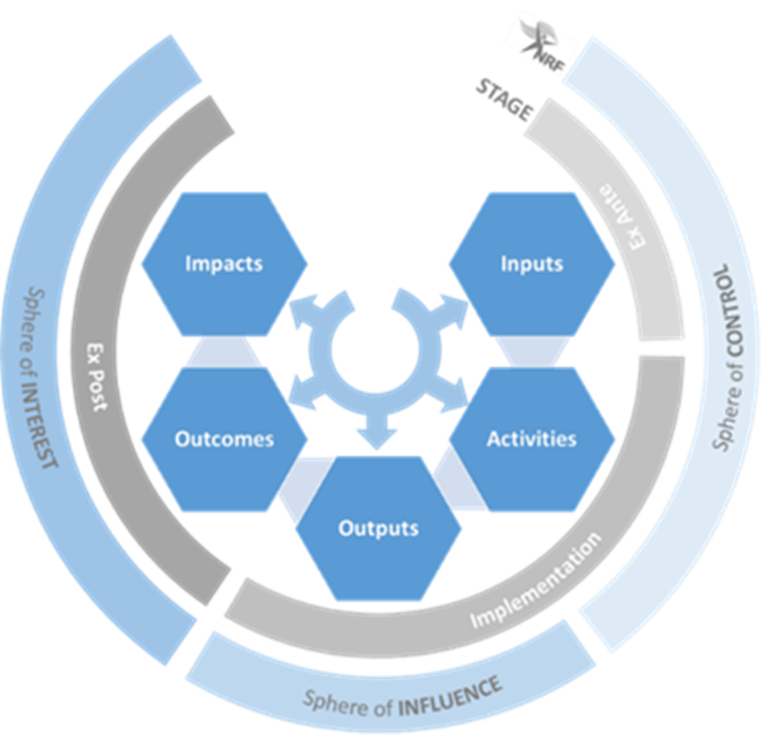

Slide 35
Unpacking the pathways
Inputs are NRF resources invested into the knowledge enterprise to support, promote and advance research impact.
Activities include any actions that directly or indirectly advance new knowledge, new applications of knowledge, innovation or human capacity development.
Outputs are the research products, new knowledge, policy briefs and policy proposals, engagement, collaboration, methods, patents and skills produced as a result of the NRF’s inputs.

Slide 36
Unpacking the pathways
Outcomes refer to the application or use of outputs by the research enterprise or by society.
Impact refers to a beneficial change in society or knowledge advancement, brought about as a direct or indirect result of the NRF’s research support interventions, whether planned or unintended; immediate or long-term.

Slide 37
Proposed assessment
Assessment will be carried out along the entire Impact Pathways.
It will include both ex-ante and ex-post assessment.
Ex-ante assessment will ensure the NRF’s processes and policies advance research impact and that the research projects that it funds are those with potential for impact.
As impact cannot be predicted, our intention is to change behaviour to encourage consideration of possible impacts and to advance methods to increase the opportunity for impact.
Ex post the NRF will focus on demonstrating impact through case studies and relevant indicators. We will not measure/compare impact or focus on attribution, but will rather communicate research impact stories.

Slide 38
High-level implications for the NRF
Policy coherence: All NRF policies and strategies to consider impact, potential impact, advancing impact. Organisational review.
Rewards and incentives: Must recognise impact/ impact pathways e.g. Impact awards, NRF ratings system.
Improve impact literacy: In NRF, researchers, NSI, and more.
Partnerships and agreements: To reflect our focus on impact, to be assessed based on potential impact, and to be established with end-users and stakeholders (assessment & reporting, outcome working groups - goverment/ business).
Enablers of impact: Consider how to enable societal impact through promoting mission-oriented, inter-disciplinary, and engaged research throughout all parts of the NRF.

Slide 39
Implementation considerations
Input stage
Need a suite of funding instruments with different weighting depending on specific purpose: transformation, potential impact, co-creation, transferability, mission-oriented, transdisciplinary.
Proposal development stage:
  Ensure that researchers imbed pathways to impact in research design and provide statement of potential impact: training for researchers, impact literacy.
  Co-creation requires interaction with end-users in the proposal development stage. How will this be supported?
Evaluation panels and peer review:
  Composition: Transformation, end-users, transdisciplinary panels. (Training. Possible payment.)
  Evaluation: matrix of criteria.

Slide 40
Implications considerations cont…
Activities stage:
Monitoring: Are impact pathways being achieved?
Annual reporting requirements.
Outputs, Outcomes and impact stage:
Post-grant reporting requirements of eventual outcomes and impact.
Partnerships outside of sphere of control.
Develop capability for in depth impact reviews.
Rating system needs to incorporate all elements of research excellence, inclusive of impact.
Rewards and incentives.

Slide 41


Slide 42
Impact of Science
23-25 June, 2021
The rest of the speakers chose not to use any presentations, please find the recordings available on the platform
#IOS21

Slide 43
Impact of Science
23-25 June, 2021
Thank you
#IOS21

